Slide 1
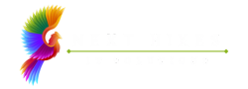
NEXTHIKE IT SOLUTIONS
NLP Project for Disaster Tweet Classification
Mr. Aniket G. Tayade.

Slide 2

DATA OVERVIEW & INITIAL SCAN
Dataset Name: twitter_disaster (1).csv
Dataset Shape: 7613 Rows, 5 Columns
Missing Values are Present in following columns:
Keyword: 61
Location: 2533

Slide 3

Data Preparation and Data Cleaning
Perform following operations on Dataset to get Cleaned Data.
Convert to string if not already
Remove URLs
Remove user mentions and hashtags (keep the text)
Remove punctuation
Remove numbers
Convert to lowercase
Remove extra whitespace
Tokenization and stopword removal
Stemming and Lemmatization

Slide 4

Feature Engineering and Model Selection
TF-IDF Vectorization
Count Vectorization
Text Length
Word Count
Combine features (example with TF-IDF + length features)

Slide 5

Model Selection and Training
Logistic Regression
Multinomial Naive Bayes
Random Forest
SVM
Model Result
Logistic Regression: F1 Score = 0.7272 (+/- 0.0352)
Multinomial Naive Bayes: F1 Score = 0.7253 (+/- 0.0314)
Random Forest: F1 Score = 0.7108 (+/- 0.0228)
SVM: F1 Score = 0.7177 (+/- 0.0354)

Slide 6
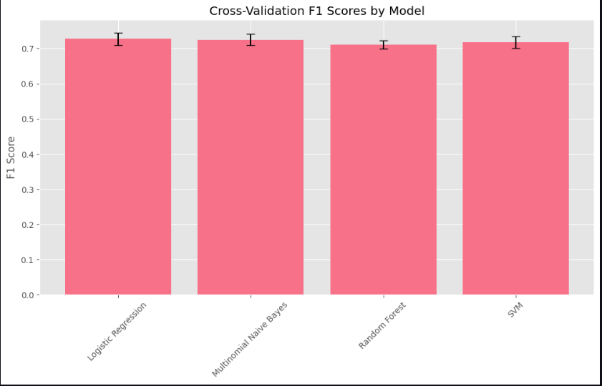
Visualize cross-validation results
Logistic Regression is on top: It shows the highest mean F1 score, slightly above 0.73, making it the best performer in this comparison.
Naive Bayes is close behind: Multinomial Naive Bayes is almost tied with Logistic Regression, only a tiny fraction lower in F1.
Random Forest lags a bit: Its bar is the lowest, a little above 0.70, suggesting it underperforms compared to the other three models.
SVM performs steadily: Support Vector Machine is slightly better than Random Forest and almost matches Naive Bayes.
Error bars are small: The narrow black lines indicate low variance across folds, meaning the cross-validation scores are stable and consistent.

Slide 7

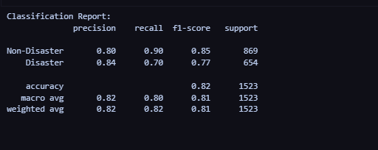
Model Evaluation Metrics
Accuracy: 0.8168
Precision: 0.8440
Recall: 0.7034 F1
Score: 0.7673

Slide 8
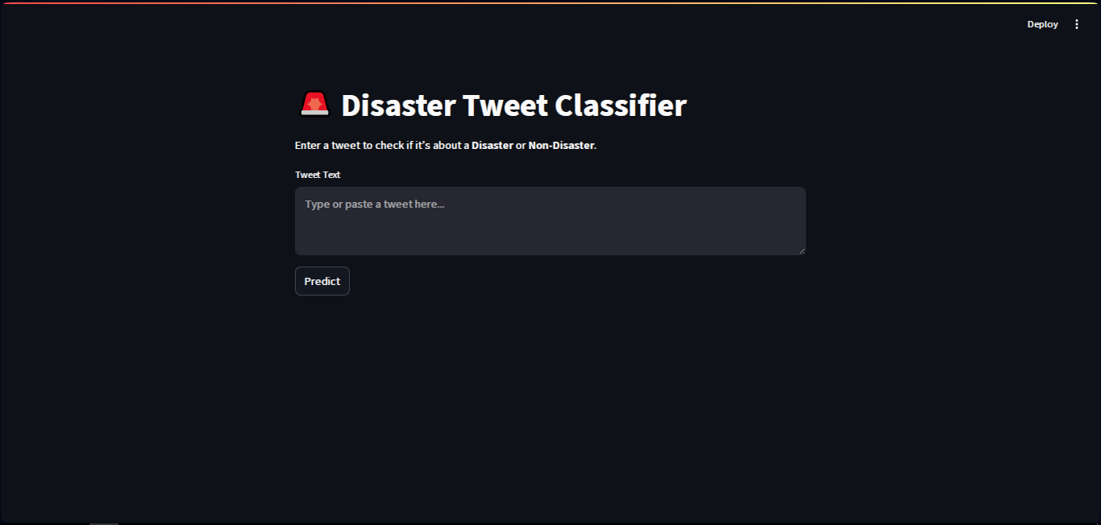
Streamlit App Screenshot

Slide 9
Thank you

